Slide 1
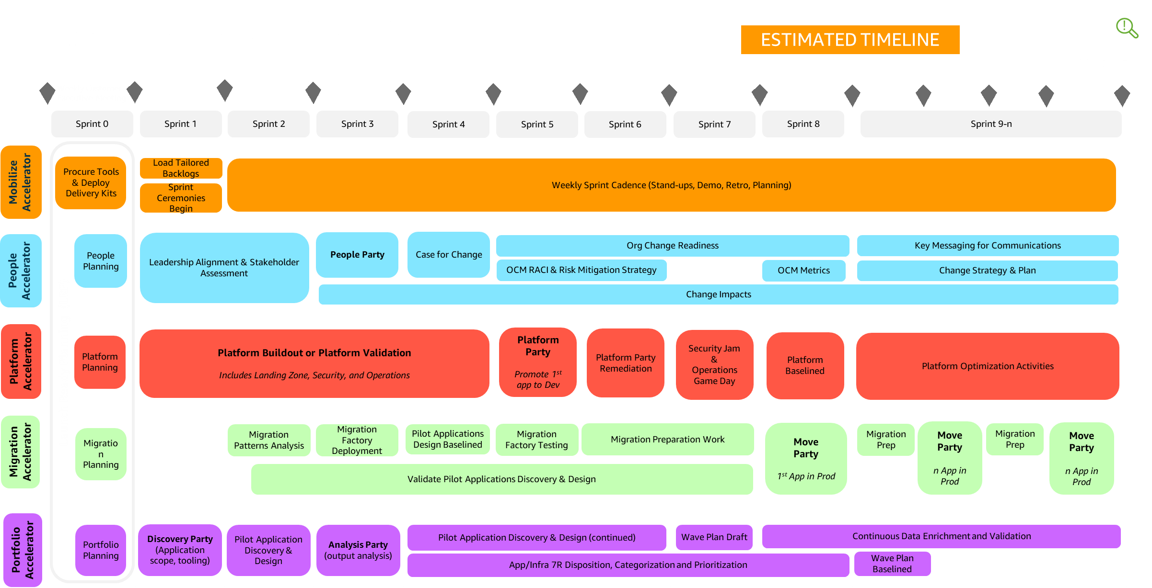
Roadmap & Timeline

